Slide 1
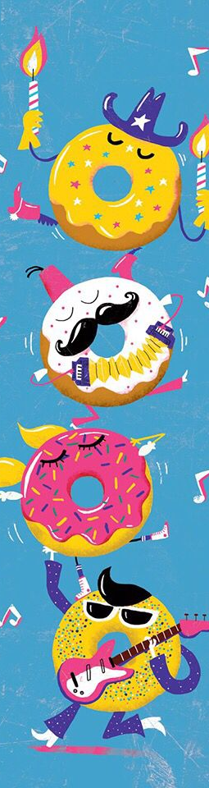
Goal: Create buzzfeed-esque quiz to classify what type of donut you are based on how you play music
Sort based on criteria:
Fast= >2 notes per second (3x)
Density= >1 notes at the same time (2x)
Tonality= >0 instances of dissonance
Classifications:
Tonal, not dense, slow- Glazed krispy kreme
Tonal, not dense, fast- Frosted with sprinkles
Tonal, dense, slow- Boston creme
Tonal, dense, fast-Devil’s food cake
Atonal, not dense, slow- Jelly donut
Atonal, not dense, fast- Cinnamon sugar cake
Atonal, dense, slow- Sour cream
Atonal, dense, fast- Pickle donut

